Slide 1
Natural language processing
Lecture 5: Sequence models
Roberta Rocca
Assistant Professor, IMC & CHC
✉️ roberta.rocca@cas.au.dk
Notes:
A “fractal” view on word2vec, where we start from the overall intuition, and we dive increasingly deeper into the architecture

Slide 2
Mid-term evaluation
Fill in the midterm evaluation (anonymous):
https://forms.gle/oigLB3sGzY5yDTxE7
Notes:
10 minutes

Slide 3
Exercise
Try to work out answers to the following questions in pairs (note down things you realize you don’t understand as you discuss). You can refer back to your notes, slides, or to the worldwide web.
What is distributional semantics? Why is it a good theory of meaning for computational linguistics and natural language processing? What is it not good for?
What are differences and commonalities between count-based and predictive approaches to meaning representation? What are the advantages and disadvantages of each?
What is word2vec? What is skipgram with negative sampling (SGNS)? Why is it a convenient way to train a word2vec model?
What is an activation function, and what is its purpose in a neural network? Can you name two activation functions and briefly describe them?
What is gradient descent, and what is its purpose? How does it relate to the notion of backpropagation?
What is a feedforward or fully-connected neural network? Can you describe a linguistic application of this kind of network, and how language can be represented in the input layer?
Notes:
25 minutes

Slide 4
Exercise
Try to work out answers to the following questions in pairs (note down things you realize you don’t understand as you discuss). You can refer back to your notes, slides, or to the worldwide web.
What is distributional semantics? Why is it a good theory of meaning for computational linguistics and natural language processing? What is it not good for?
What are differences and commonalities between count-based and predictive approaches to meaning representation? What are the advantages and disadvantages of each?
What is word2vec? What is skipgram with negative sampling (SGNS)? Why is it a convenient way to train a word2vec model?
What is an activation function, and what is its purpose in a neural network? Can you name two activation functions and briefly describe them?
What is gradient descent, and what is its purpose? How does it relate to the notion of backpropagation?
What is a feedforward or fully-connected neural network? Can you describe a linguistic application of this kind of network, and how language can be represented in the input layer?
Notes:
25 minutes

Slide 5
Recap
We have looked at ways to represent the meaning of words or sentences based on distributional properties of text
We have looked at neural networks as ways to:
Learn good word representations
Process text representations to perform predictive tasks (e.g., classification)
We have looked at feedforward neural networks
There are ways to use these models to do things like sentiment classification or named entity recognition
… what are the downsides of this approach?
Notes:
i.e., stacked collections of "perceptrons" that independently apply linear transformations to their inputs, sum the results of these linear transformations, and then apply a non-linearity

Slide 6
Meaning representation so far
So far, we have represented the meaning of a word as:
Co-occurrences with other words
Word vectors learned from a predictive task
Correspondingly, the meaning of a sentence/paragraph/document:
Normalized counts of words occurring in it
Averaged or concatenated word vectors
These approaches are computationally very convenient, but …

Slide 7
Downsides
The meaning of words is not static: it varies (slightly or dramatically) as a function of the surrounding context
“I’ll get the drinks” / “He’ll get scared!”
“The bird had broken his wing” / “The airport has a new wing”
Our approach to representing sentences bears no traces of the order in which items occur…

Slide 8
The importance of sequential structure (1)
“The student praised the teacher” / “The teacher praised the student”
“The show was bad, not good at all!” / “The show was good, not bad at all!”
With all the approaches to sequence representation we have seen so far, these sentences would have the exact same representation!

Slide 9
The importance of sequential structure (2)
Which word is missing from these sentences?
the
their
told
the teacher told the students to open their _
to
open
the
students
teacher
Notes:
Same as word2vec… much easier to do when word order is present!

Slide 10
The importance of sequential structure (2)
Order provides rich information when it comes to predictive tasks like Word2Vec’s training task (e.g., grammatical relations)
Predictive coding is a dominant paradigm in theories of human language processing
Our heuristics seem to rely a lot on sequential order
Notes:
Same as word2vec… much easier to do when word order is present!

Slide 11
Limitations of fully connected networks
Fully connected NNs cannot model sequential input as such
They can concatenate representations for multiple words as inputs…
Q: does concatenation with FFNs solve the problem?
Not really, as it only works:
For fixed-input sequences
For rather short sequences (# parameters grows easily)
For some tasks (i.e., tasks with fixed outputs and no sequential dependencies: what does this exclude?)
Notes:
This, for example, does not include machine translation, summarization, etc.

Slide 12
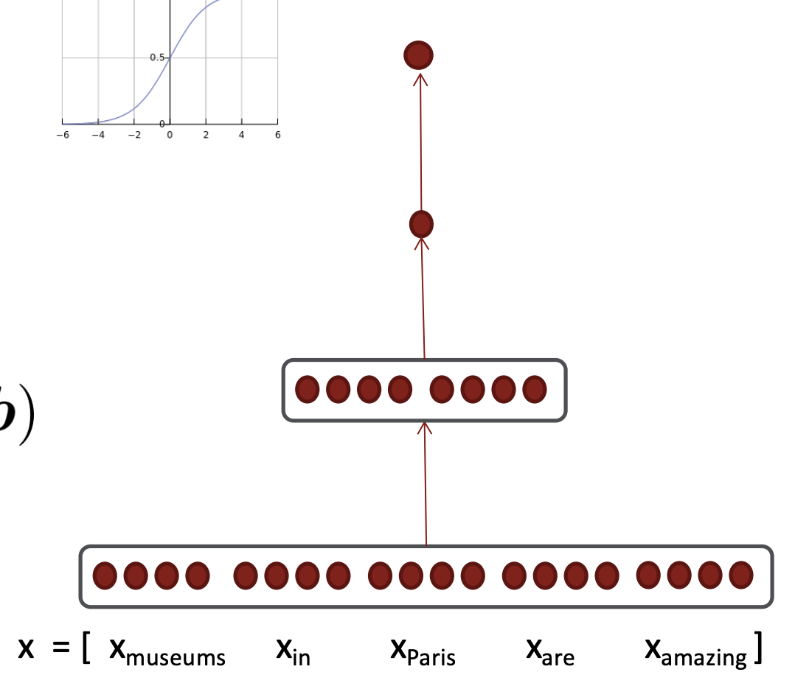
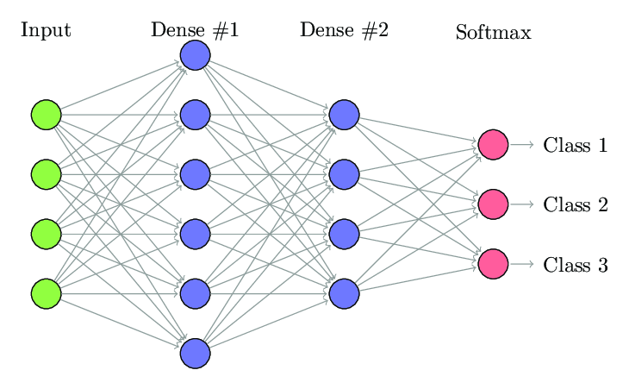
Limitations of fully connected networks
Sentiment: [0,1]

Slide 13
Are there any models that can…
Yield contextualized representations of individual words (i.e., informed by preceding context)
Yield sequence-level representations that account for sequential structure
Process a variable and possibly long number of inputs?
[produce a variable number of outputs?]
Notes:
This, for example, does not include machine translation, summarization, etc.

Slide 14
Today’s plan
A deeper dive into language modeling
Introducing recurrent neural networks (RNNs)
Problems with RNNs
A better sequence model: long short-term memory (LSTM)
Notes:
This, for example, does not include machine translation, summarization, etc.

Slide 15
Language modeling
Predicting a center word from context words or vice versa has proven a very powerful intuition for NLP
Language modeling is a “better” version of this task: predict the next word based on preceding context
Closer to what humans do, as language is “received” sequentially
Notes:
This, for example, does not include machine translation, summarization, etc.

Slide 16
Language modeling
the teacher told the students to open their _
the teacher told the students to open their books
the teacher told the students to open their laptops
the teacher told the students to open their mouths
the teacher told the students to open their giraffe
the teacher told the students to open their eating
lots of semantic, syntactic, and world knowledge goes into being able to do this
Notes:
This, for example, does not include machine translation, summarization, etc.

Slide 17
Language modeling
Benchmark for general language understanding capabilities
It is a subcomponent of many NLP tasks, especially those involving generating text or estimating the probability of text
It is a pretraining method for approaches based on transfer learning (more in the coming weeks!)
Notes:
This, for example, does not include machine translation, summarization, etc.

Slide 18
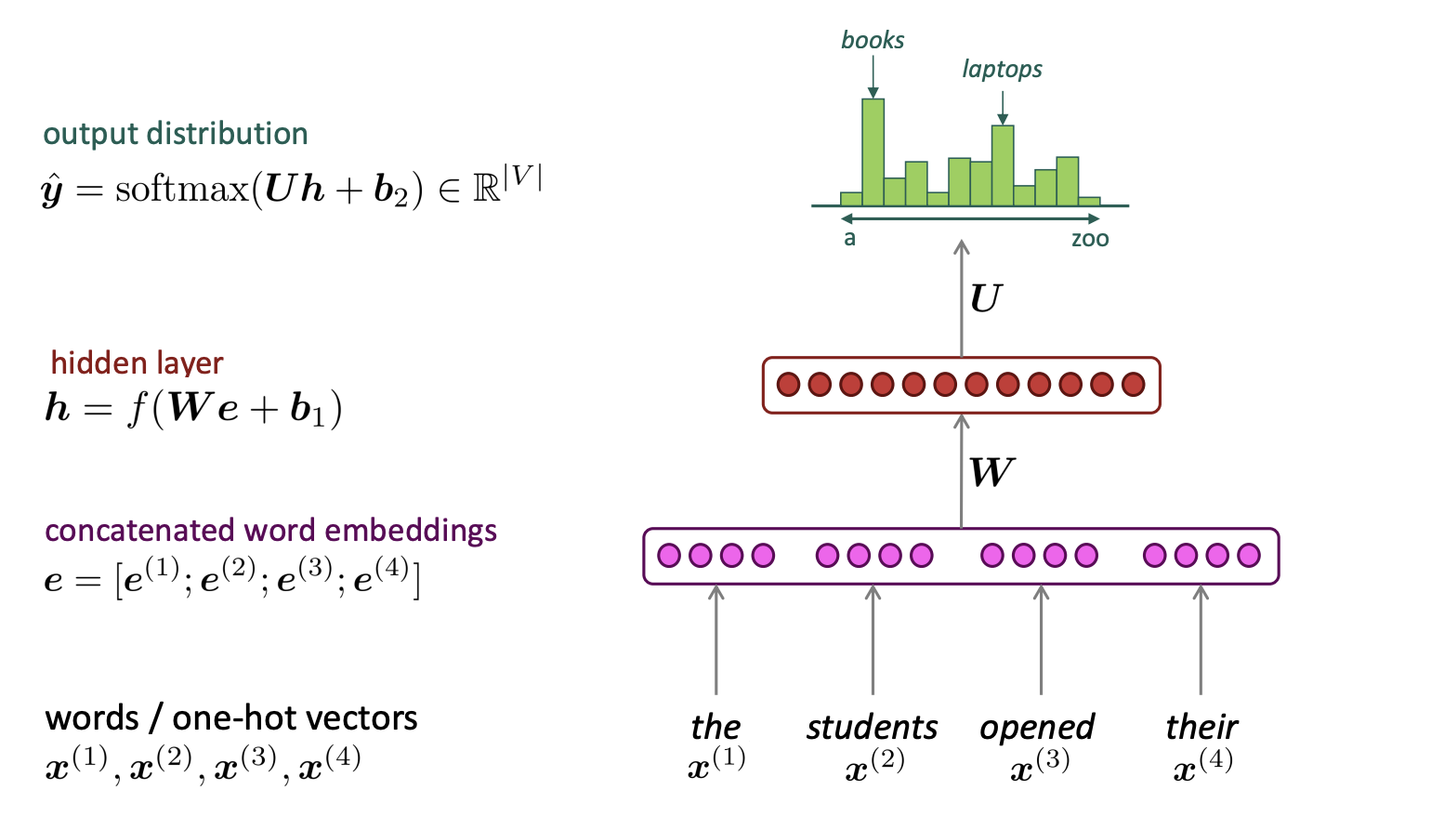
Language modeling with FFNs
Notes:
This, for example, does not include machine translation, summarization, etc.

Slide 19
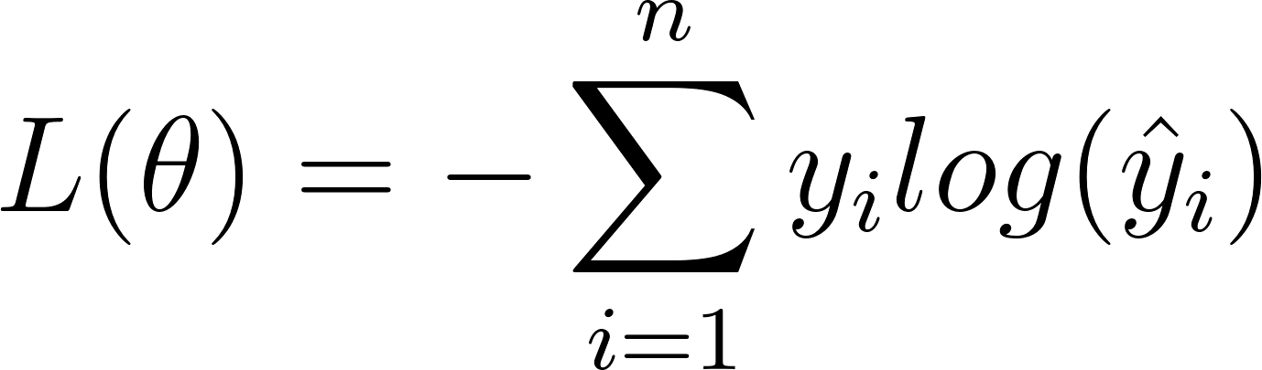
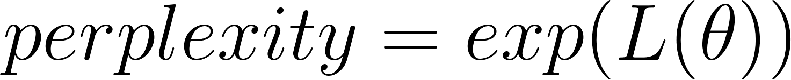
How do we measure performance?
Loss: cross-entropy (a generalization of the loss for binary classification) quantifies to what extent the predicted probability distribution differs from the true probability distribution
Perplexity: exponentiated cross-entropy loss comparable across models
Notes:
Cross-Entropy: Average number of total bits to represent an event from Q instead of P. (similar to KL divergence)
If you toss a coin of n sides (where n=perplexity) you get one.

Slide 20
Language modeling with FFNs: downsides
Fixed window is very small
Enlarging window enlarges the number of parameters
Very rigid encoding of position: first word is always multiplied by the same weights…
The resulting performance is suboptimal
Notes:
This, for example, does not include machine translation, summarization, etc.

Slide 21
Recurrent Neural Networks
To perform language modeling optimally, we need a model that can encode the sequential structure of language
Recurrent neural networks are the architecture we are after
Language modeling ≠ RNNs, but RNNs are a good architecture for language modeling
How do RNNs work?
Notes:
This, for example, does not include machine translation, summarization, etc.

Slide 22
Recurrent Neural Networks
Recursively applies the same parameters to each “step” of the input (here, words)
Propagates a state which keeps a record of previous steps
Can produce an output at each step
Output vector
y_{n}
y₁
y₂
y₃
y₄
h_{t}
h₁
h₂
h₃
x_{n}
x₁
x₂
x₃
x₄
Input vector
Notes:
This, for example, does not include machine translation, summarization, etc.

Slide 23
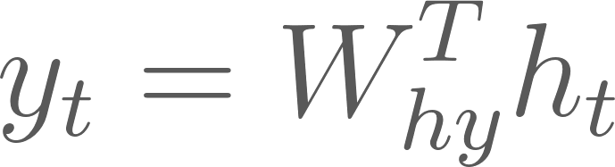

Computing hidden states and output vectors
Output vector
Output vector
y_{n}
h_{t}
Hidden state
x_{n}
Input vector
Input vector
Notes:
Note that the hidden state (and as a consequence the output) are a function of both input and previous hidden states!

Slide 24
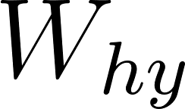
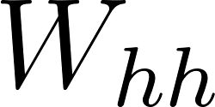
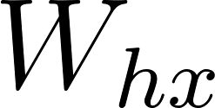
Computing hidden states and output vectors
y₁
y₂
y₃
y₄
x₁
x₂
x₃
x₄
Notes:
Note that the hidden state (and as a consequence the output) are a function of both input and previous hidden states!

Slide 25
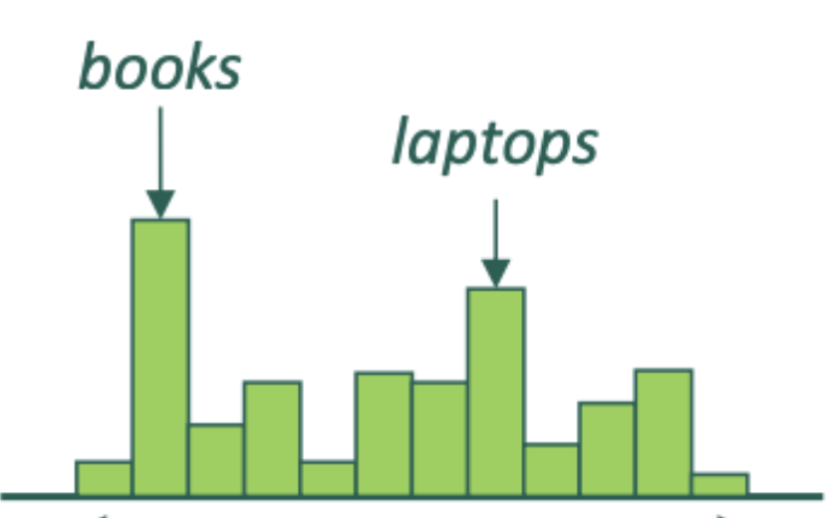
Language modeling (LM) with RNNs
Output: Probability distribution for next word
y₁
y₂
y₃
y₄
x₁
Input:
A vector representation of the input word
x₂
x₃
x₄
the
students
opened
their
Notes:
You would output probability distributions at each state

Slide 26
Meaning representations in a LM-RNN
Hidden states are contextualized representations of a given word
The final state can be interpreted as a sequence-level representation
Alternatively, you can average hidden states at all steps to represent a sequence
Output vector
y_{n}
y₁
y₂
y₃
y₄
h_{t}
h₁
h₂
h₃
x_{n}
x₁
x₂
x₃
x₄
Input vector
Notes:
This, for example, does not include machine translation, summarization, etc.

Slide 27
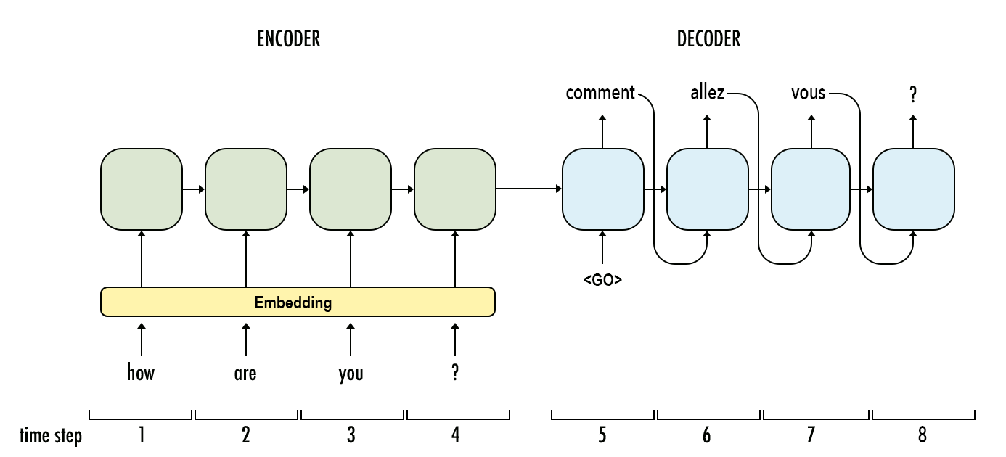
A “many-to-many” application of RNNs (machine translation)
Notes:
Encoder decoder architectures… until it hit an end state! Can generate endless numbers of tokens

Slide 28
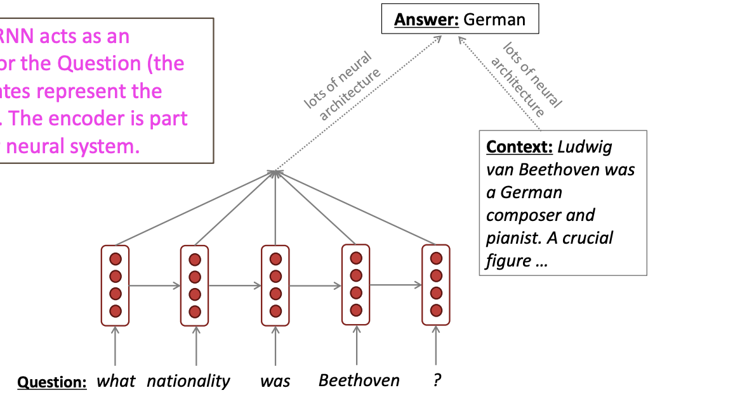
RNN encoders for complex tasks (question answering)
Notes:
Note that the hidden state (and as a consequence the output) are a function of both input and previous hidden states!

Slide 29
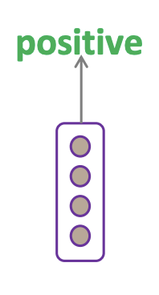
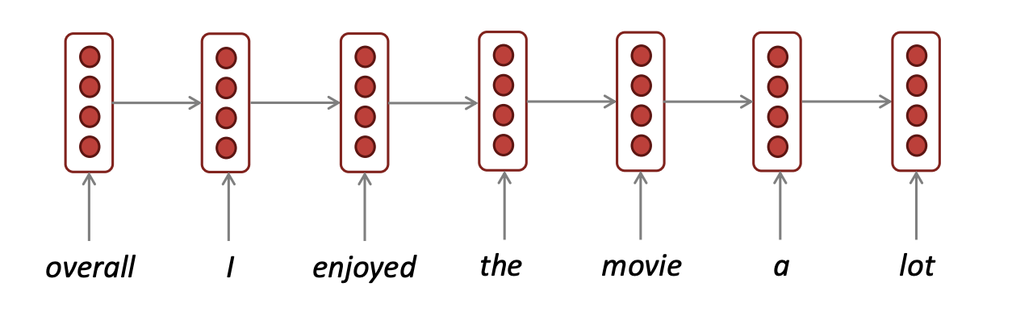
A “many-to-one” application of RNNs (sentiment classification)
Notes:
Note that the hidden state (and as a consequence the output) are a function of both input and previous hidden states!

Slide 30
Computing the loss
L
L₁
L₂
L₃
L₄
y₁
y₂
y₃
y₄
x₁
x₂
x₃
x₄
Notes:
(taking the many to-many scenario as example)

Slide 31
Are there any models that can…
Yield contextualized representations of individual words (i.e., informed by preceding context)
Yield sequence-level representations that account for sequential structure
Process a variable and possibly long number of inputs?
[produce a variable number of outputs?]
Notes:
This, for example, does not include machine translation, summarization, etc.

Slide 32
Backpropagation through time (BPTT)
L
Forward pass
Backpropagation
L₁
L₂
L₃
L₄
y₁
y₂
y₃
y₄
x₁
x₂
x₃
x₄
Notes:
Note that the hidden state (and as a consequence the output) are a function of both input and previous hidden states!

Slide 33
Issues with RNNs
Due to the recursive multiplication of gradients and weight matrices, backpropagation through time is prone to vanishing or exploding gradients
If the gradients / weight matrix have high values, gradients become huge as you backpropagate them (can be solved with gradient clipping)
If the gradients / weights have values < 0, recursive multiplication yields extremely low gradients
Notes:
This, for example, does not include machine translation, summarization, etc.

Slide 34
Why are vanishing gradients a problem?
The model does not learn beyond a certain step
In an RNN, this tends to be very few steps (5-10)
This makes it impossible to model long-term dependencies, which are often important in language
“I was born in France and grew up there, my parents were winemakers from the Southern part of the country. I only recently moved to Denmark, to start an undergraduate programme in Cognitive Science. I speak fluent English and _”
Notes:
This, for example, does not include machine translation, summarization, etc.

Slide 35
Long short-term memory (LSTM): rationale
The problem with RNNs is that they are not really able to retain information over many time steps
Can we develop an architecture that is good at preserving this information, in ways that are relevant for the task it is trying to solve?
This is where LSTMs can help
Notes:
This, for example, does not include machine translation, summarization, etc.

Slide 36
Long short-term memory (LSTM)
LSTMs are recurrent models where the flow of information is controlled by three main operations
The input gate decides which information from the input is added to the hidden state (which we now call a cell state)
The forget gate decided which information from previous hidden states is removed from the hidden state
The output gate decides which information from the hidden state is propagated to the output
Notes:
This, for example, does not include machine translation, summarization, etc.

Slide 37
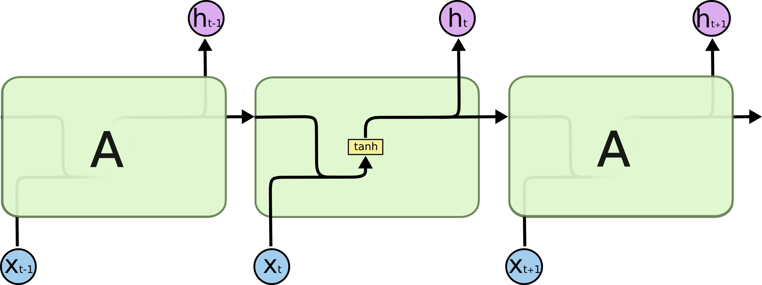
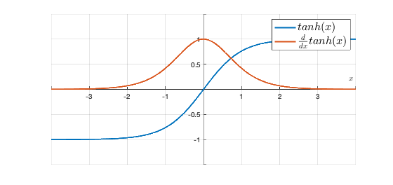
LSTMs
Another way of visualizing RNNs: our starting point to understand LSTMs
Notes:
Vanishing gradients and LSTMs

Slide 38

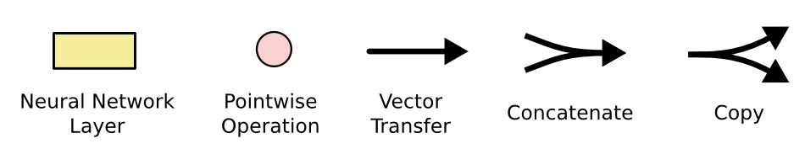
LSTMs
The basic architecture of the LSTM is essentially the same, but we now apply four operations (layers)
We will work this out in a moment :)

Slide 39
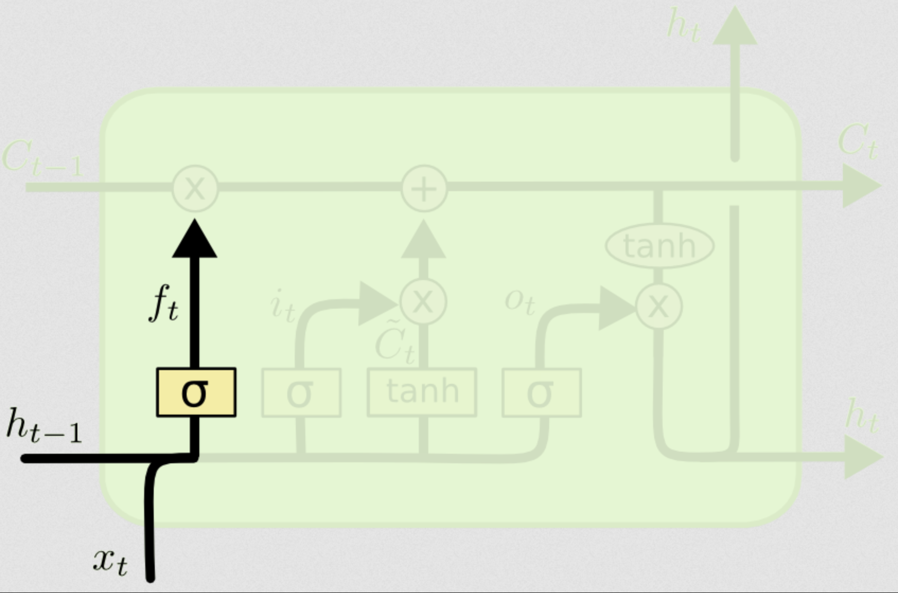
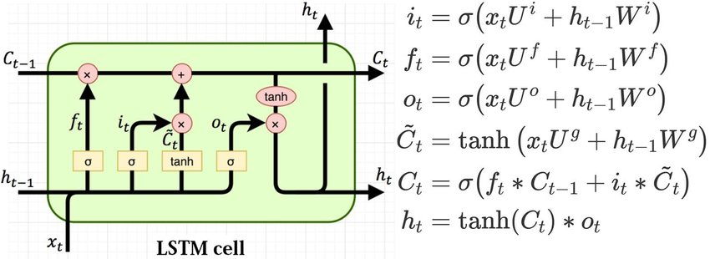
The forget gate
The first step is to decide what we are going to remove from the cell state
This is done by the first logistic layer called the forget gate
It looks at h_{t−1} and x_{t} and return a number between 0 and 1 for each dimension of the hidden state
0 = completely forget
1 = completely remember
This output is used in a pointwise multiplication of the cell state C_{t−1}

Slide 40
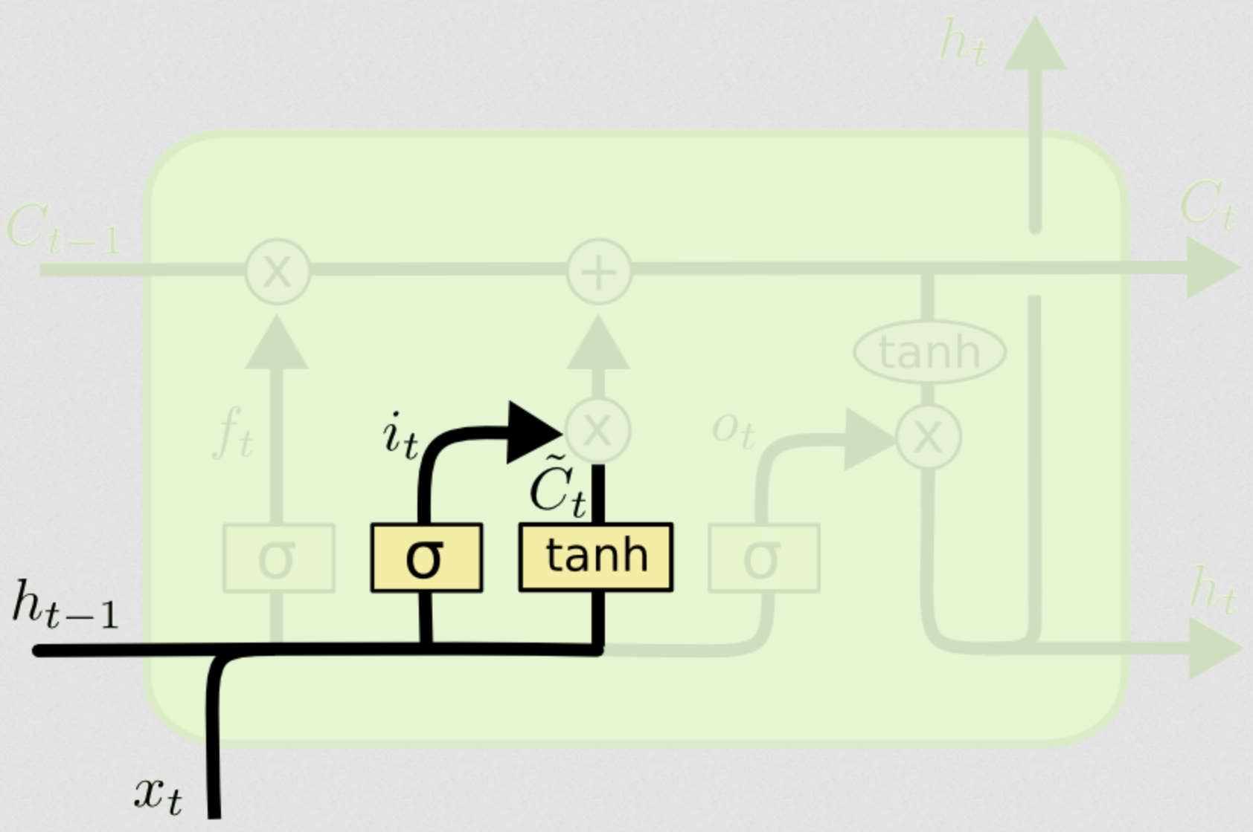
The input gate
We now want to update the old cell by adding the new input from both h_{t−1} and x_{t}
The logistic function (0,1) here is called the input gate which decides which values will update
The tanh layer creates a vector of new candidate values
Notes:
Logistic function can output values between zero and one. Tanh normalizes input values.
They are both applied to a combination of both the hidden state and the input.
The hidden

Slide 41
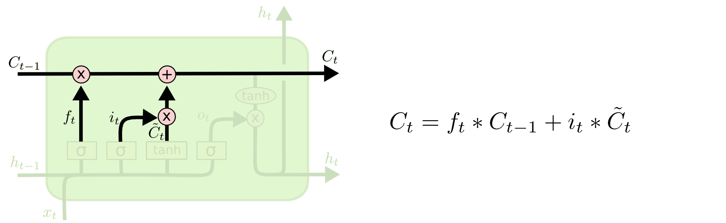
The final cell state
So we take the previous cell state and multiply it by the output of the forget gate
This is then added to the output acquired from multiplying the candidate values by the output from the input gate
This final cell state C_{t} is then pushed down the line to the next block

Slide 42
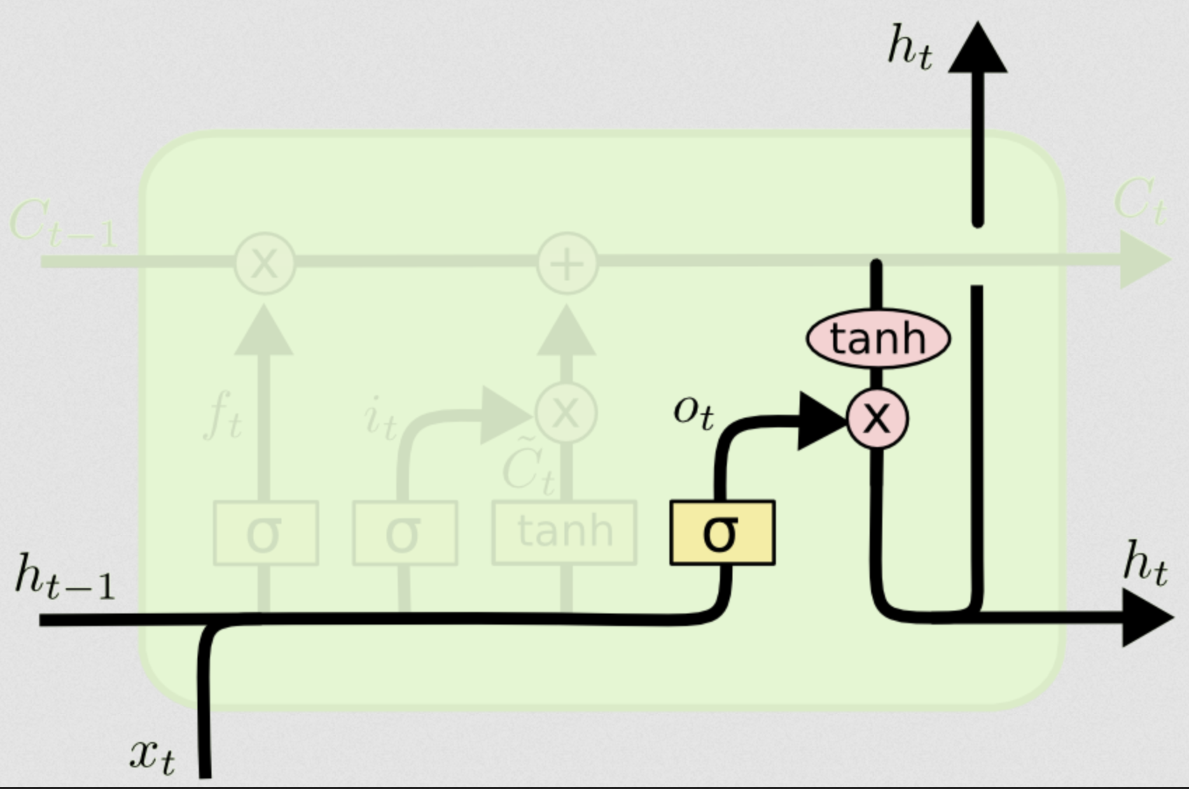
The output gate
The last step is create a hidden state which is passed forward through the network
Notice how C_{t-1} and h_{t-1} are utilised differently in the module
We run the concatenation of h_{t-1} and x_{t} through a logistic function
We also run C_{t} through a tanh function and then multiple those together to create h_{t}
So h_{t} is based on (but is not identical to) our cell state C_{t}

Slide 43
Cell state versus hidden state
The cell state is the long-term memory of the network
The hidden state is its working memory (it is the cell state “augmented” with relevant information from the current input)
The resulting models are able to retain information over many more steps!

Slide 44
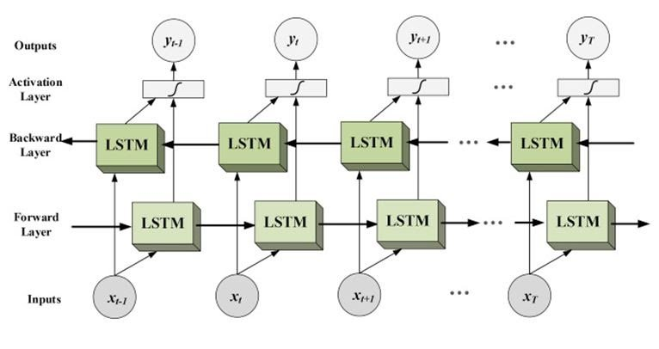
Bi-Directional LSTMs
While LSTMs solve many of the issues of RNNs they only process input unidirectionally
But meaning of words sometimes depends on words that come after (and sentence-level interpretation is updated based on later information)
The old man the boat
Until the police arrest the gangsters controlled the street.
In this case, we use two LSTM networks simultaneously – one going forward and one going backward

Slide 45
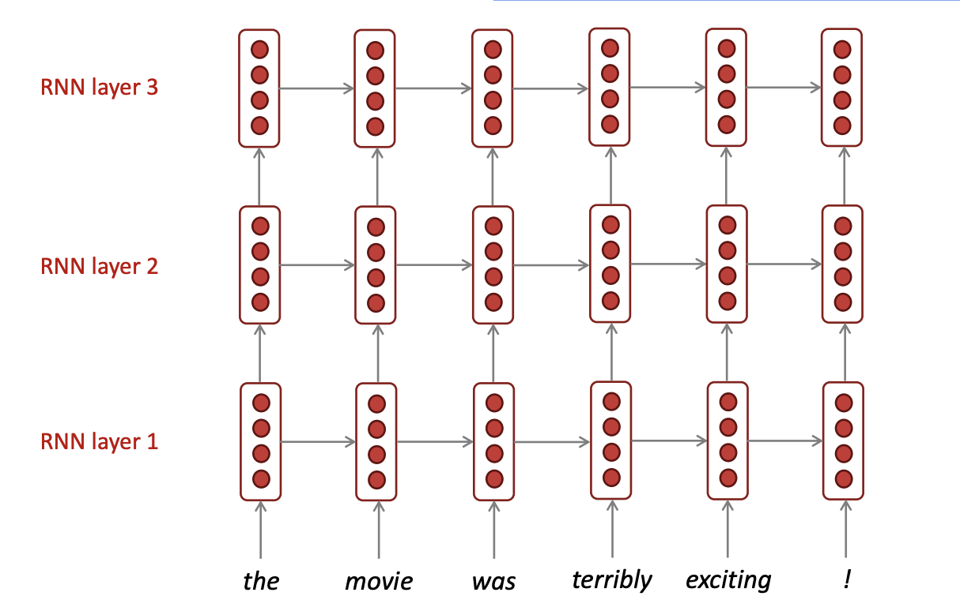
Multi-layer RNNs

Slide 46
Summary
Language is sequential and temporarily ordered: temporal order carries information relevant to meaning
Language modeling is a simple “sequential” task that operationalizes what a good model of meaning should be able to do (and has analogies with human language processing)
Recurrent neural networks are a good choice for creating neural language models, insofar as they are inherently designed to model sequential data
RNNs suffer (greatly) from the vanishing gradient problem and struggle with long-distance dependencies which are frequent in natural language
Long short term memory (LSTM) networks address this problem by adding a combination of different gates which regulate how information is passed along the chain of modules
Bi-directional LSTM models traverse the input data twice, once forward and once backward, with both passes being given equal weighting

Slide 47
See you tomorrow!

Slide 48
Additional reading
Research articles
Bengio, Y., Simard, P.Y., Frasconi, P. (1994). ‘Learning long-term dependencies with gradient descent is difficult’, IEEE Transactions on Neural Networks, 5(2), 157-66.
Futrell, R. & Levy, R.P. (2019). “Do RNNs learn human-like abstract word order preferences?”, Proceedings of the Society for Computation in Linguistics (SCiL) 2019, pp. 50–59.
van Schijndel, M. & Linzen, T. (2021). "Single-stage prediction models do not explain the magnitude of syntactic disambiguation difficulty”, Cognitive Science, 45 (6): e12988. 2021.
Wilcox, E., Levy, R.P., & Futrell, R. (2019). “What Syntactic Structures Block Dependencies in RNN Language Models?”, Proceedings of the 41st Annual Meeting of the Cognitive Science Society, pp. 1199–1205.
Blog posts
Awesome and well-known blog post http://colah.github.io/posts/2015-08-Understanding-LSTMs/
Some nice animated visualisations here: https://towardsdatascience.com/illustrated-guide-to-lstms-and-gru-s-a-step-by-step-explanation-44e9eb85bf21

